Slide 1
Retrieving Data Using the SQL SELECT Statement
1

Slide 2
Objectives
After completing this lesson, you should be able to do the following:
List the capabilities of SQL SELECT statements
Execute a basic SELECT statement

Slide 3
Lesson Agenda
Basic SELECT statement
Arithmetic expressions and NULL values in the SELECT statement
Column aliases
Use of concatenation operator, literal character strings, alternative quote operator, and the DISTINCT keyword
DESCRIBE command

Slide 4
Basic SELECT Statement
SELECT *|{[DISTINCT] column|expression [alias],...} FROM table;
SELECT identifies the columns to be displayed.
FROM identifies the table containing those columns.

Slide 5
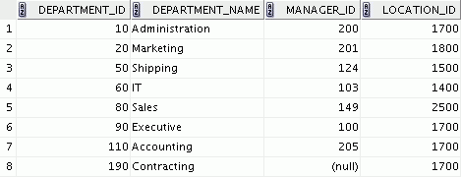
Selecting All Columns
SELECT *
FROM departments;

Slide 6
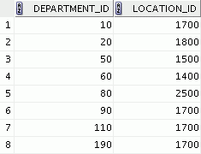
Selecting Specific Columns
SELECT
FROM departments;
department_id, location_id

Slide 7
Writing SQL Statements
SQL statements are not case sensitive.
SQL statements can be entered on one or more lines.
Keywords cannot be abbreviated or split across lines.
Clauses are usually placed on separate lines.
Indents are used to enhance readability.
In SQL Developer, SQL statements can be optionally terminated by a semicolon (;). Semicolons are required when you execute multiple SQL statements.
In SQL*Plus, you are required to end each SQL statement with a semicolon (;).

Slide 8
Arithmetic Expressions
Create expressions with number and date data by using arithmetic operators.
Operator | Description
+ | Add
- | Subtract
* | Multiply
/ | Divide

Slide 9
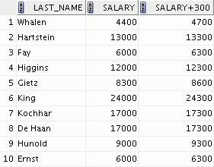
Using Arithmetic Operators
SELECT last_name, salary, FROM employees;
salary + 300
…

Slide 10


Operator Precedence
SELECT last_name, salary, FROM employees;
12*salary+100
1
…
SELECT last_name, salary, FROM employees;
12*(salary+100)
2
…
Notes:
Parentheses
* /
+ -
= <> < > <= >=
IS (IS NULL, IS NOT NULL)
BETWEEN
NOT
AND
OR

Slide 11


Defining a Null Value
Null is a value that is unavailable, unassigned, unknown, or inapplicable.
Null is not the same as zero or a blank space.
SELECT last_name, job_id, salary, FROM employees;
commission_pct
…

Slide 12


Null Values in Arithmetic Expressions
Arithmetic expressions containing a null value evaluate to null.
SELECT last_name, FROM employees;
12*salary*commission_pct
…

Slide 13
Defining a Column Alias
A column alias:
Renames a column heading
Is useful with calculations
Immediately follows the column name (There can also be the optional AS keyword between the column name and the alias.)
Requires double quotation marks if it contains spaces or special characters, or if it is case-sensitive

Slide 14


Using Column Aliases
SELECT last_name AS name, commission_pct FROM employees;
comm
…
SELECT last_name
"Name"
, salary*12
"Annual Salary"
FROM employees;
…

Slide 15
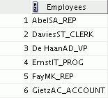
Concatenation Operator
A concatenation operator:
Links columns or character strings to other columns
Is represented by two vertical bars (||)
Creates a resultant column that is a character expression
SELECT | last_name||job_id | AS | "Employees"
FROM | employees;
…

Slide 16
Literal Character Strings
A literal is a character, a number, or a date that is included in the SELECT statement.
Date and character literal values must be enclosed within single quotation marks.

Slide 17
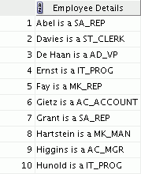
Using Literal Character Strings
SELECT last_name ||' is a '||job_id AS "Employee Details"
FROM employees;
…

Slide 18
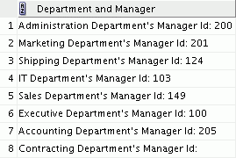
Alternative Quote (q) Operator
Specify your own quotation mark delimiter.
SELECT department_name ||
|| manager_id
AS "Department and Manager" FROM departments;
q'[ Department's Manager Id: ]'

Slide 19
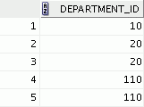
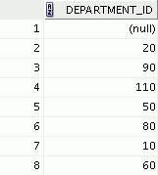
Duplicate Rows
The default display of queries is all rows, including duplicate rows.
1
2
SELECT department_id FROM employees;
SELECT department_id FROM employees;
DISTINCT
…

Slide 20
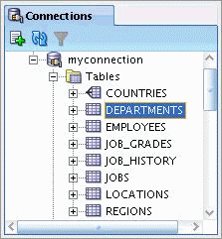
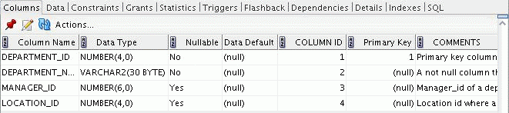
Displaying the Table Structure
Use the DESCRIBE command to display the structure of a table.
Or, select the table in the Connections tree and use the Columns tab to view the table structure.
DESC[RIBE] tablename

Slide 21
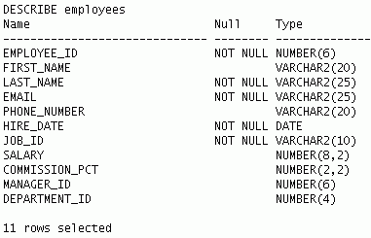
Using the DESCRIBE Command
DESCRIBE employees

Slide 22
Summary
In this lesson, you should have learned how to:
Write a SELECT statement that:
Returns all rows and columns from a table
Returns specified columns from a table
Uses column aliases to display more descriptive column headings
SELECT *|{[DISTINCT] column|expression [alias],...} FROM table;

Slide 23
Practice 1: Overview
This practice covers the following topics:
Selecting all data from different tables
Describing the structure of tables
Performing arithmetic calculations and specifying column names

